Slide 1

Early detection of Alzheimer’s Diseases using Deep Learning Techniques
By: Edem Dziko

Slide 2
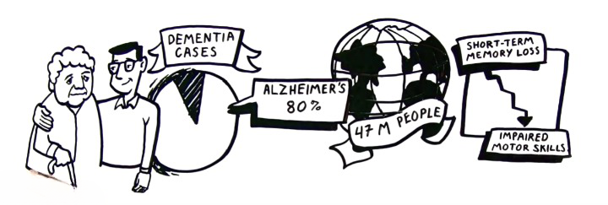

Did you know??
94m
People expected to be diagnosed with AZ by 2050
-De Leon et al. (2004)

Slide 3
The Problem & Aims
Research Problem
The research problem at hand is the pressing need for early diagnoses of Alzheimer's disease.
Early detection provides an opportunity to slow down the progression of the disease
(Qiu, Kivipelto. and Von Strauss., 2022)
01
Research Objective
To develop and compare the performance of a CNN model with Transfer Learning models which
would accurately predict all four stages of Alzheimer’s Disease using brain MRIs.
02

Slide 4
Similar Work Done
Researchers | Year | Dataset | Methods | Model Evaluation
Sarraf et al. | 2016 | ADNI | LeNet-5 CNN architecture | 97%
Basaia et al. | 2019 | ADNI, non-ADNI | CNN model using 3D MRI | 99%
Juan et al. | 2020 | ADNI | 3D Densely Connected CNN | 83%
Pradhan et al. | 2021 | Kaggle | VGG19, DenseNet169 | 88%, 78%
Choi and Lee | 2022 | ADNI | Ensemble of multiple DNNs | 93.84%

Slide 5
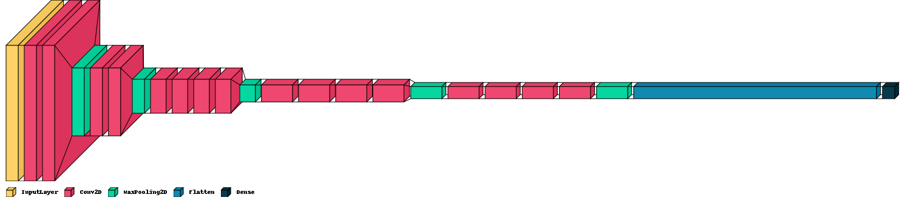
Methodology
Proposed VGG19 Model
Notes:
The proposed model for this multiclass classfication is a modified VGG19 model made up of 5 convolutional blocks, each followed by a max pooling layer.
Each convolutional block consists of two or more convolutional layers with a filter size of 3x3 and a stride of 1.
A flatten layer which converts 3D feature maps into a 1D feature vector is added
There are 3 fully connected layers and one dense layer which has 4 units using the softmax activation function.

Slide 6

Next Steps?

Slide 7

Thank you

